Slide 1
Impact of Car Features
(Project – 7)
- BY HITISHA SONI

Slide 2
Project Description :-
The automotive industry has been rapidly evolving over the past few decades, with a growing focus on fuel efficiency, environmental sustainability, and technological innovation.
With increasing competition among manufacturers and a changing consumer landscape, it has become more important than ever to understand the factors that drive consumer demand for cars.
In recent years, there has been a growing trend towards electric and hybrid vehicles and increased interest in alternative fuel sources such as hydrogen and natural gas. At the same time, traditional gasoline-powered cars remain dominant in the market, with varying fuel types and grades available to consumers.

Slide 3
Approach :-
We have given a 1 datasets containing 11,914 rows.
car_data

Slide 4
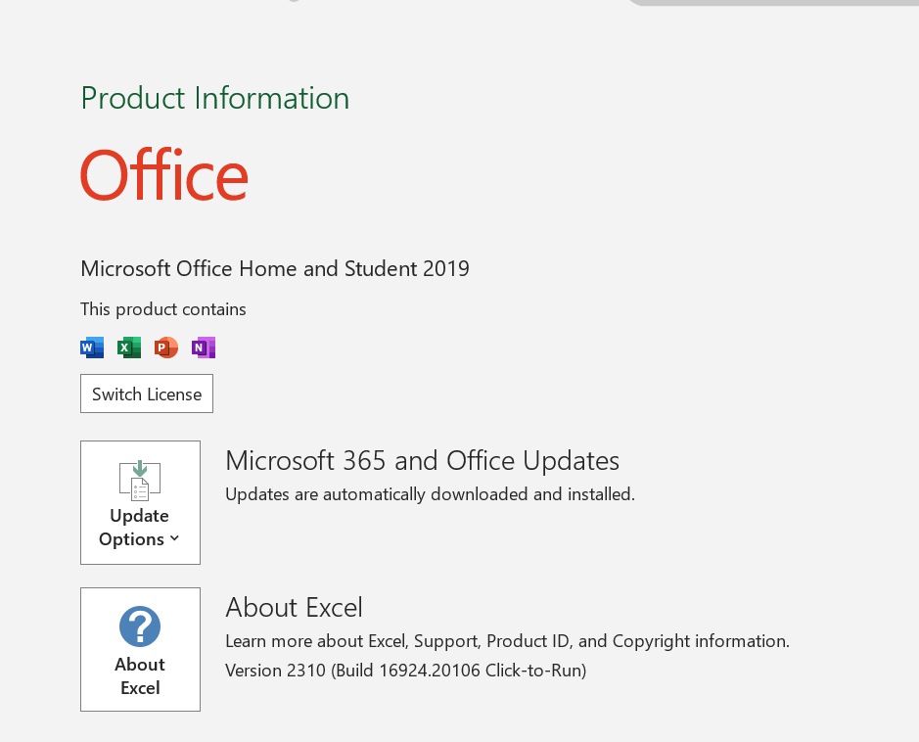
Tech-Stack Used:-

Slide 5
Tasks:
Link to Excel file

Slide 6
Insight Required: How does the popularity of a car model vary across different market categories?
Task 1.A: Create a pivot table that shows the number of car models in each market category and their corresponding popularity scores.
Task 1.B: Create a combo chart that visualizes the relationship between market category and popularity.

Slide 8
Insight Required: What is the relationship between a car's engine power and its price?
Task 2: Create a scatter chart that plots engine power on the x-axis and price on the y-axis. Add a trendline to the chart to visualize the relationship between these variables.

Slide 10
Insight Required: Which car features are most important in determining a car's price?
Task 3: Use regression analysis to identify the variables that have the strongest relationship with a car's price. Then create a bar chart that shows the coefficient values for each variable to visualize their relative importance.

Slide 12
Insight Required: How does the average price of a car vary across different manufacturers?
Task 4.A: Create a pivot table that shows the average price of cars for each manufacturer.
Task 4.B: Create a bar chart or a horizontal stacked bar chart that visualizes the relationship between manufacturer and average price.

Slide 14
Insight Required: What is the relationship between fuel efficiency and the number of cylinders in a car's engine?
Task 5.A: Create a scatter plot with the number of cylinders on the x-axis and highway MPG on the y-axis. Then create a trendline on the scatter plot to visually estimate the slope of the relationship and assess its significance.
Task 5.B: Calculate the correlation coefficient between the number of cylinders and highway MPG to quantify the strength and direction of the relationship.

Slide 16
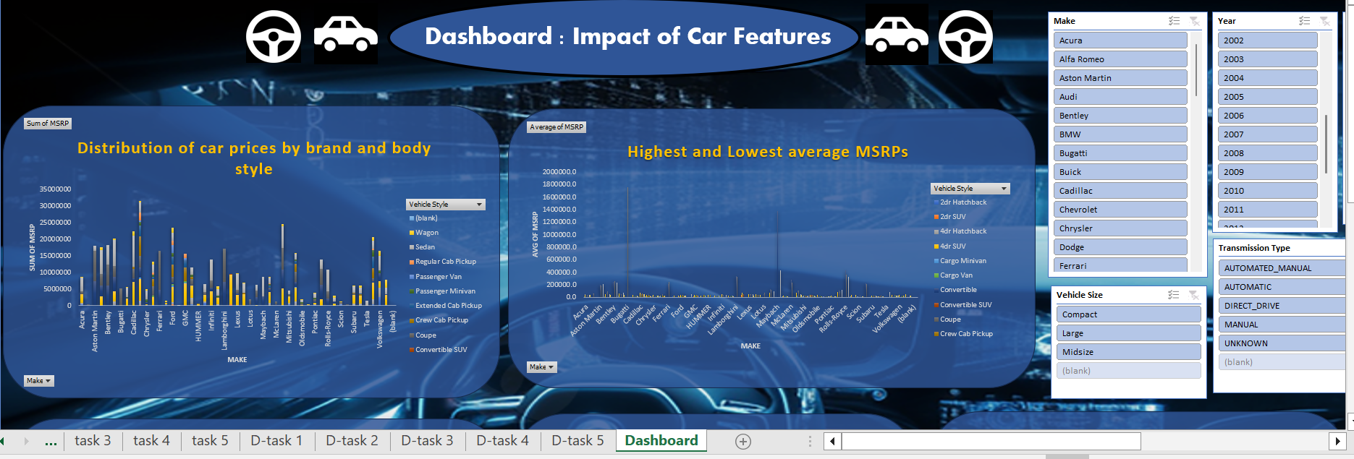
Tasks: Dashboard

Slide 17
Task 1: How does the distribution of car prices vary by brand and body style?
Hints: Stacked column chart to show the distribution of car prices by brand and body style. Use filters and slicers to make the chart interactive. Calculate the total MSRP for each brand and body style using SUMIF or Pivot Tables.

Slide 19
Task 2: Which car brands have the highest and lowest average MSRPs, and how does this vary by body style?
Hints: Clustered column chart to compare the average MSRPs across different car brands and body styles. Calculate the average MSRP for each brand and body style using AVERAGEIF or Pivot Tables.

Slide 21
Task 3: How do the different feature such as transmission type affect the MSRP, and how does this vary by body style?
Hints: Scatter plot chart to visualize the relationship between MSRP and transmission type, with different symbols for each body style. Calculate the average MSRP for each combination of transmission type and body style using AVERAGEIFS or Pivot Tables.

Slide 23
Task 4: How does the fuel efficiency of cars vary across different body styles and model years?
Hints: Line chart to show the trend of fuel efficiency (MPG) over time for each body style. Calculate the average MPG for each combination of body style and model year using AVERAGEIFS or Pivot Tables.

Slide 25
Task 5: How does the car's horsepower, MPG, and price vary across different Brands?
Hints: Bubble chart to visualize the relationship between horsepower, MPG, and price across different car brands. Assign different colors to each brand and label the bubbles with the car model name. Calculate the average horsepower, MPG, and MSRP for each car brand using AVERAGEIFS or Pivot Tables.

Slide 27
Thank You

